Slide 1
Table of Contents
Background and Problem.
Data Sources.
Methodology.
Results.
Conclusion.
Discussion.

Slide 2
Intro: Background and Problem
Background:
New York City rank number 1 populous city in the United States, most visited tourist city, has many districts and landmarks are well known. It has 5 boroughs: The Bronx, Brooklyn, Manhattan, Queens and Staten Island. New York City has plenty of neighborhoods: 306 neighborhoods. Planning to move to New York City is exciting and challenging at the same time due to its many of neighborhoods.
Problem:
This project is to determine which neighborhood has plenty of restaurants nearby.

Slide 3
Data Sources
New York City boroughs, neighbodhhoods, longtitute and latitude data from https://cocl.us/new_york_dataset.
Venue, its longitude and its latitude coordinates from Four Square API, focus on restaurants only.

Slide 4
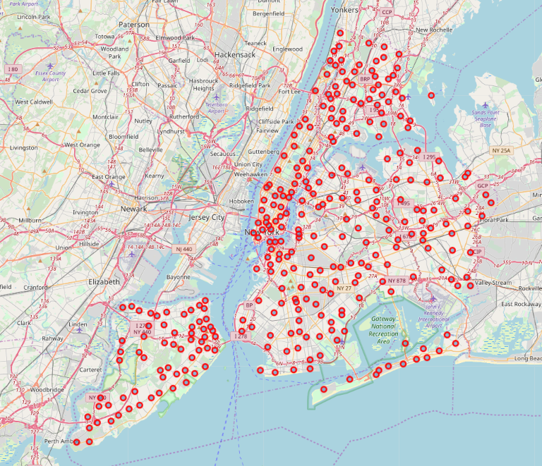
New York City Map with Neighborhoods

Slide 5
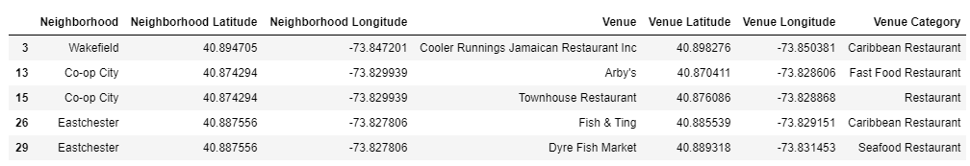
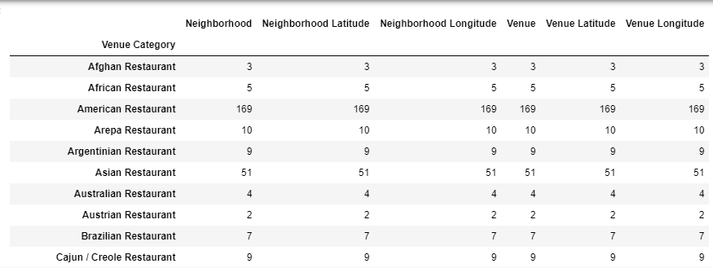
List of Restaurants in New York City’s Neighborhood from Four Square

Slide 6
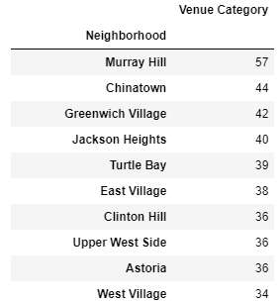
Top 10 Neighborhood with number of restaurants nearby

Slide 7
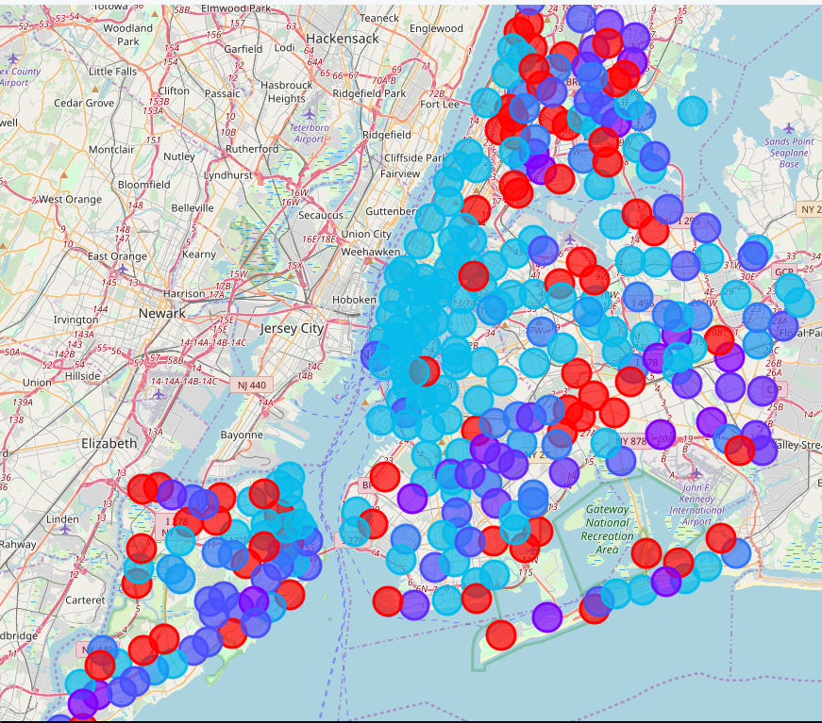
Restaurants Cluster by Neighborhoods

Slide 8
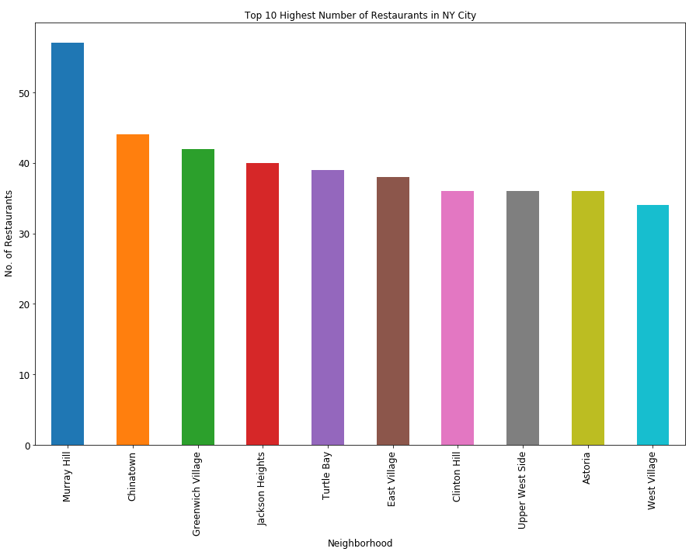
Top 10 Neighborhoods Recommendation

Slide 9
Summary
Murray Hill neighborhood is number one recommendation for this category. Murray Hill is located in Manhattan borough which also the most dense borough in the New York City. The Empire State, Times Square and Broadway are located in Manhattan borough too.

Slide 10
Link to the codes:
https://dataplatform.cloud.ibm.com/analytics/notebooks/v2/8e9b13b3-e4e5-466a-a79a-74dc019e71bf/view?access_token=5889a797098bcfd06325139e997efa6f3db00dd4c2fa1fe840658cddd8a5e07f

